Slide 1
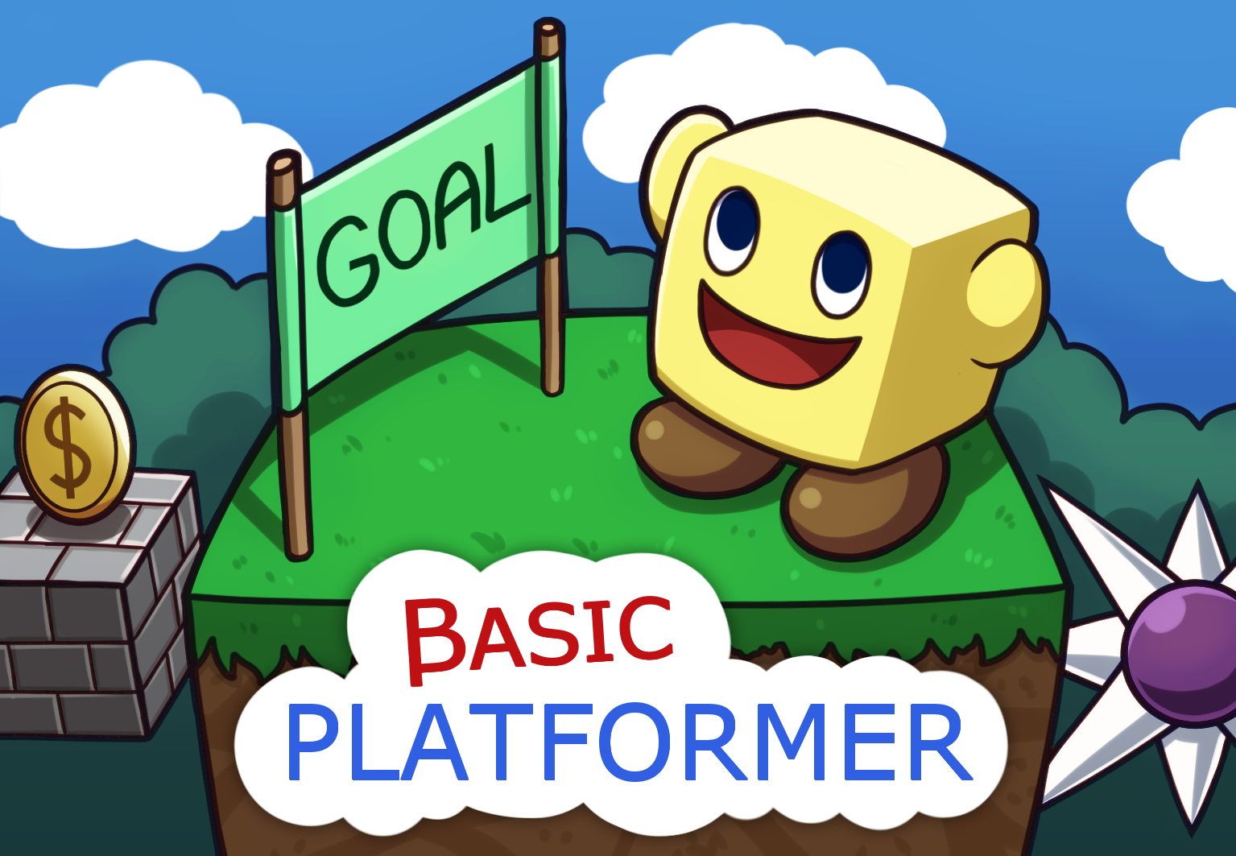
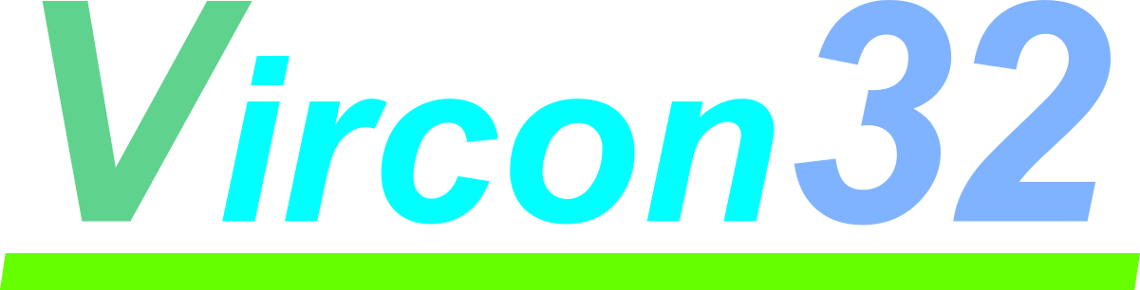

Collect every coin on your hard way to victory, in 30 levels full of obstacles!
PAL / NTSC / OTHER
Multi-region
Cartridge
32-BIT VIRTUAL CONSOLE

